Slide 1
Bolton’s Town Deal – Projects Update 8th December 2022 Public Realm only

Slide 2
Recap on Progress to date
Development of Town Investment Plan
Community engagement and development of the Town Investment Plan - Summer 2020 to MHCLG – now DLUHC
Identified and prioritised 4 projects
Wellsprings- creation of hub for digital and cultural businesses
Bolton Market upgrades
Bolton Library & Museum Upgrades
Public Realm Improvements
Town Investment Plan submitted October 2020
Funding Offer
Accelerated Funding £1m July 2020
Heads of Terms received March 2021
Acceptance of funding offer following Board agreement March 23rd. (£22.9m to support all four projects (£2.1m less than originally asked for)

Slide 3
Recap on Progress to date
Development of Business Cases
Appointment of Business Case specialist advisors – Savills March 2021
Individual project costs reviewed and reprioritised May 2021.
Business cases for all four projects submitted along with monitoring & evaluation plan Nov 2021.
Business Cases approved and signed off Feb 2022.
Programme Delivery
Multi-disciplinary Project teams established for each project with a lead Project Officer.
Programme Manager overseeing all projects to keep on track.
First payment drawn down March 2022.
Second payment drawn down August 2022.
All projects must be delivered by March 2026.

Slide 4
Public realm & green spaces
Description:
Improved public realm and new greenspace in the Cheadle Square area, covering refurbishment, public art installations, lighting and wayfinding.
Programme:
Blackhorse Street Phase 1 Final snagging ongoing
Cheadle Gardens Oct 23 – May 24
Linear Park Oct 23 – May 24
Cheadle Square Oct 23 – Aug 24
Blackhorse Street Phase 2 May 24 – Oct 24
Cost: £6.24m
Challenges:
Phasing around wider TC developments
Unforeseen costs below ground
Rising costs and availability of materials
Timeliness of utilities companies

Slide 5
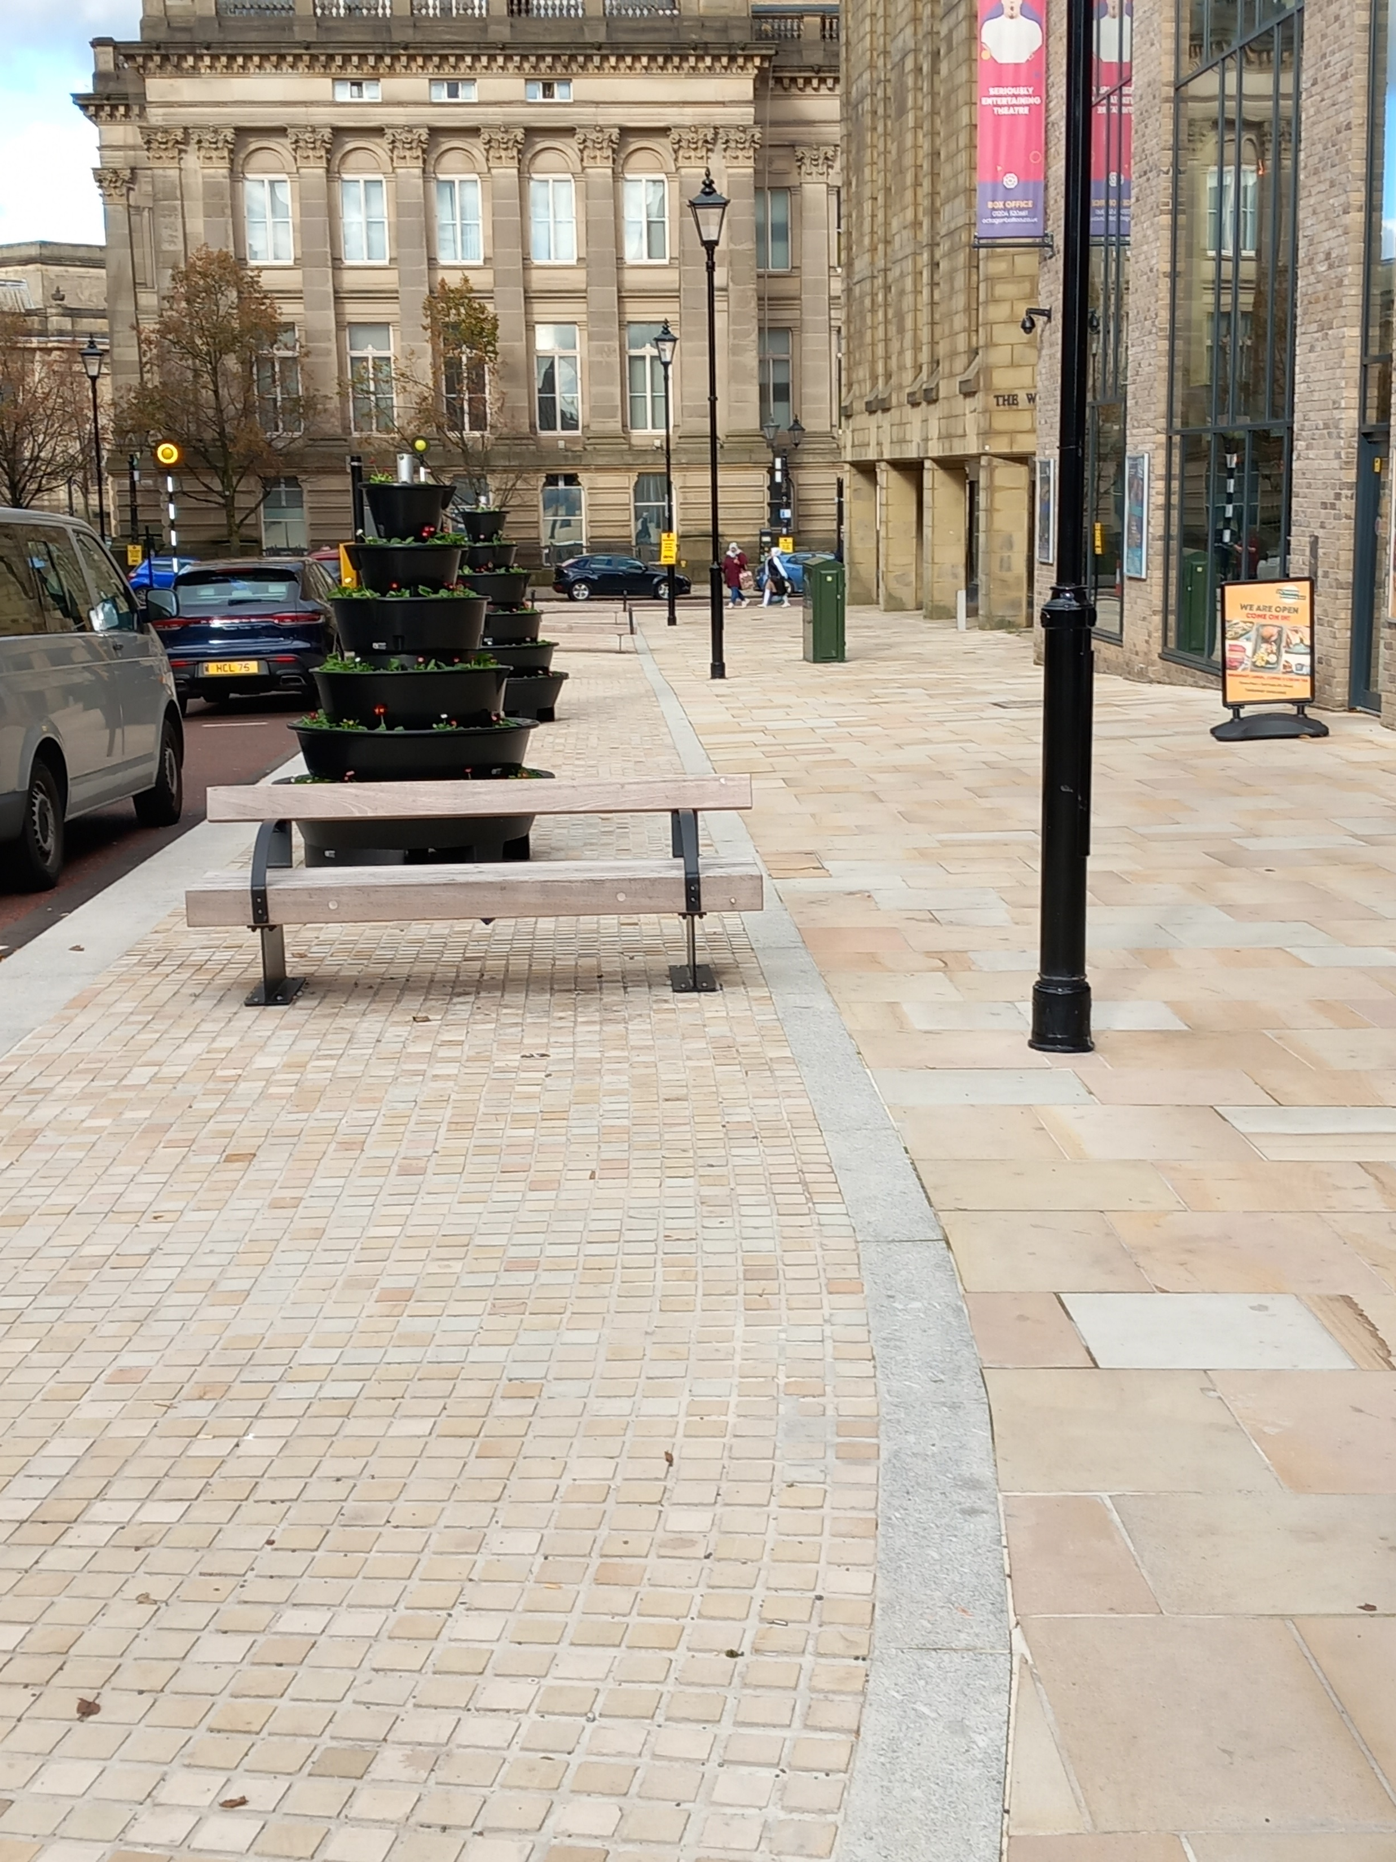
Public realm – Accelerated Funding
Description:
Improved public realm and new greenspace in the Cheadle Square area, covering refurbishment and new public space.
Programme:
Howell Croft/Ashburner Street Final snagging ongoing
Elizabeth Park Jan 23 – July 23
Cost: £1m
Challenges:
Phasing around wider TC developments
Unforeseen costs below ground
Rising costs and availability of materials
Timeliness of utilities companies

Slide 6
Project | Towns Fund Allocation | Other Funding | Total Project Cost | Spend to Date | Project RAG | Comments
Library | £3.73m | £700k | £4.43m | £359k | On target | Add funding secured
Market | £5.59m | £0 | £5.59m | £1.23m | On target | Progressing well
Wellsprings | £6.92m | £1.9m* | £8.82m* | £150k | Delayed | UKSPF Bid submitted
Public Realm | £7.24m | £0 | £7.24m | £1.56m | On target | Includes £1m accelerated
Cultural Dev | £221k | £0 | £221k | £0 |  | Linked to Wellsprings
Cost Control/Mgt | £185k | £0 | £185k | £45k |  | Governance and external validation of cost challenges
Totals | £23.9m | £2.6m | £26.5m | £3.34m |  | * Require additional funding *

